Slide 1
IDC 3931 – Big Data
Statistics 101

Slide 2
Course Modules/Technologies Used!
Course Module | Technology Used
Data Warehousing | SQL Server
Statistical Analysis | Teradata
Data Mining 840 Million Rows | Teradata
Text Mining – Sentiment Analysis | Semantria – Excel Add-in
Data Visualization | Tableau
Data Cleansing | SQL Server – Data Quality Services

Slide 3
Objectives
To provide the beginnings of the statistical knowledge needed for the course
This will provide the base knowledge and we will supplement with additional knowledge as the need arrives

Slide 4
Data Collection Types/Techniques
Qualitative – expressed verbally rather than numerically
Conversations
Magazine articles
Media broadcasts
Quantitative – numerical values
Surveys
Experiments
Categorical
Species
Cat
Human
Can’t be a Batman or Catwoman

Slide 5
Variable Types (Categorical)
Nominal – two things that are equivalent in some sense and are given the same name or number
The name or number is nothing more than a way of grouping similar things together (can’t do math on them)
NFL Player numbers mean things like QB numbers are between 1-19, OL are in 60-79, etc. but adding 12 to 65 does not get you an offensive QB
Zip Codes are a way of grouping buildings together but adding zip codes means nothing
62650 (Jacksonville, IL)
-32301 (Tallahassee)
30349 (Atlanta)
Ordinal – when categories are ordered and the order means something
Olympic Finishes: 1st Place/2nd Place/3rd Place
Shirt Sizes: S, M, L, XL
Tells us more than nominal data but still don’t tell us about the differences between the points on a scale
Binary (not 0 or 1)
Male/Female
Yes/No

Slide 6
Variable Types (Quantitative)
Discrete– countable number of distinct values (usually whole numbers)
# of children
Points scored in a football game

Slide 7
Variable Types (Quantitative cont’d)
Continuous – infinitely uncountable values on whatever scale we are using
Examples:
Time
Number Line
Return on investment
Interval
RateMyProfessor on a continuous scale between 1 & 5
Grading scales: 90-92 = A- 92-100 = A
Salaries
Temperatures – the diff between 100 & 90 is the same as 90 & 80
Ratio – goes a step further than interval by requiring that the ratio of values along the scale are meaningful.
A rating of 4 is twice as good as a rating of 2.
Weight
When a variable = 0.0, there is NONE of that variable
Degf vs. DegC vs DegK = no/no/yes

Slide 8
Why do the variable types matter?
Because you can only do certain types of statistical analyses on certain variable types!
OK to compute.... | Nominal | Ordinal | Interval | Ratio
frequency distribution. | Yes | Yes | Yes | Yes
median and percentiles. | No | Yes | Yes | Yes
add or subtract. | No | No | Yes | Yes
mean, standard deviation, standard error of the mean. | No | No | Yes | Yes
ratio, or coefficient of variation. | No | No | No | Yes

Slide 9
Summarizing Qualitative Data
Frequency Distribution – grouping data into categories and recording the number of observations that fall into each category
Opponent | FSU Score | Opp Score | W/L
Murray State | 69 | 3 | W
Savannah State | 55 | 0 | W
Wake Forest | 52 | 0 | W
Clemson | 49 | 37 | W
USF | 30 | 17 | W
NC State | 16 | 17 | L
Boston College | 51 | 7 | W
Miami | 33 | 20 | W
Duke | 48 | 7 | W
Va Tech | 28 | 22 | W
Maryland | 41 | 14 | W
Florida | 26 | 37 | L
Ga Tech | 21 | 15 | W
Northern Illinois | 40 | 24 | W
Wins | Losses
12 | 2

Slide 10
Summarizing Quantitative Data
Cumulative Frequency Distribution – records the number of observations that falls below the upper limit of each class.
Bin | Frequency
2 | 4
3 | 1
4 | 1
5 | 0
6 | 1
7 | 2
8 | 0
9 | 1
10 | 0
11 | 1
12 | 0
Bin | Frequency | Cumulative %
2 | 4 | 36.36%
3 | 1 | 45.45%
4 | 1 | 54.55%
5 | 0 | 54.55%
6 | 1 | 63.64%
7 | 2 | 81.82%
8 | 0 | 81.82%
9 | 1 | 90.91%
10 | 0 | 90.91%
11 | 1 | 100.00%
12 | 0 | 100.00%

Slide 11
Visualizing Frequency Distributions - Histograms

Slide 12
Skewness
Skewness = 0 means data evenly distributed on
both sides of the mean
Skewness > 0 means data positively skewed
Extreme values on the right tail
These values pull the mean UP
The handle of the “Bell” determines the skewness
Skewness < 0 means data negatively skewed
Extreme values on the left tail
These values pull the mean DOWN
Notes:
If the skewness is approximately 0, it is best to use the mean as the measure of central location.

Slide 13
Ogive Chart
Ogive – a graph that plots the cumulative frequency or the cumulative relative frequency of each class against the upper limit of the corresponding class

Slide 14
Ogive Chart
Ogive – a graph that plots the cumulative frequency or the cumulative relative frequency of each class against the upper limit of the corresponding class

Slide 15
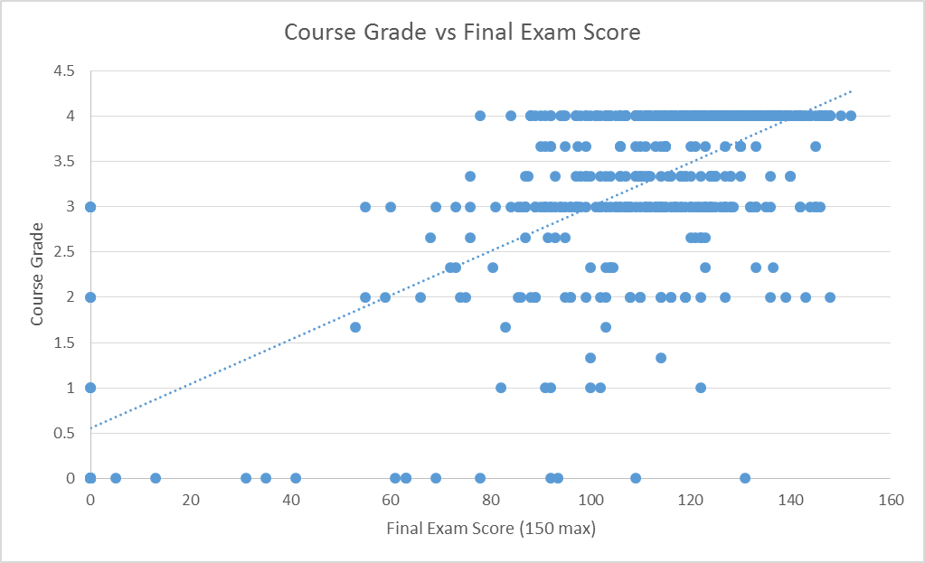
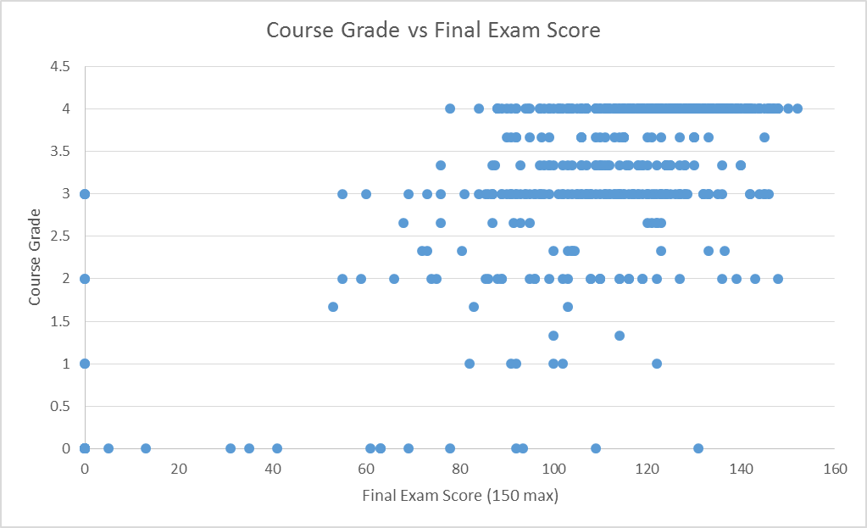
Scatterplots
Plotting relationships between TWO variables
Scatterplot – helps in determining whether or not two variables are related in some systematic way.
Each point in the diagram represents a pair of known or observed values of the two variables
http://www.tylervigen.com/spurious-correlations

Slide 16
Numerically Descriptive Statistics
Measures of Central Location
Aka: give me a “Typical” or “Central” value that describes the data
Mean (average)
Median
Mode
Notes:
There can be 2 or more modes ( numbers that occur most frequently). In excel you can get all the mode values by using mode.mult, else use mode.sing. Ex: f(x){= mode.mult(B1:B10)}

Slide 17
Numerically Descriptive Statistics - Mean
Average Example
2
4
5
9
Average = sum/count of samples = 20/4 = 5

Slide 18
Numerically Descriptive Statistics - Median
The MIDDLE of the dataset
Arrange the data in ascending or descending order
Find the middle
If there are an odd number of samples, the middle value is the median
If there are an even number of samples, the middle value is the average of the two middle values
The median is especially useful when outliers are present
Median income is $46,326
Mean income is $63,344

Slide 19
Numerically Descriptive Statistics - Mode
The value(s) that occur MOST frequently
Mode = 3
Number (Quantitative)
1
2
3
3
3
4
5

Slide 20
Craps – Dice Example
dice roll | counts
2 | 33
3 | 61
4 | 105
5 | 100
6 | 122
7 | 153
8 | 140
9 | 120
10 | 80
11 | 59
12 | 27

Slide 21
Craps – Dice Example
Column1
Mean | 7.032
Standard Error | 0.076516866
Median | 7
Mode | 7
Standard Deviation | 2.41967577
Sample Variance | 5.854830831
Kurtosis | -0.663185599
Skewness | -0.03196858
Range | 10
Minimum | 2
Maximum | 12
Sum | 7032
Count | 1000
Notes:
Use the analysis toolpak excel add-in (found under ‘file’)

Slide 22
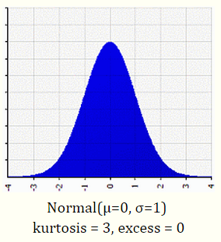
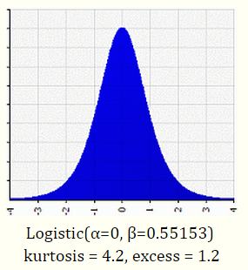
Kurtosis
Kurtosis > 0 means data:
More peaked
Kurtosis < 0 means data:
Less peaked

Slide 23
Quartiles
Number
10
11
11
12
14
15
15
16
17
19
20
22
The three points that divide the data set into four equal groups
Each group comprising a quarter of the data.
One definition of the lower quartile is the middle number between the smallest number and the median of the data set.
The second quartile is the middle observation,
also the median of the data.
The third quartile can be measured as the middle value between the median and highest values of the data set.
Q1= 11.5
Q2= 15
Q3= 18

Slide 24
Percentiles
Provide detailed information about how data are spread over the interval from the smallest value to the largest value.
SAT scores
Math range from 200-800
If your score was 600… well how good is that?
If you know that that was in the 75th percentile
You did better than 75% of the students
You did worse than 25% of the students
i.e. 75% of the students had scores lower than your score
…25% of the students had scores higher than your score

Slide 25
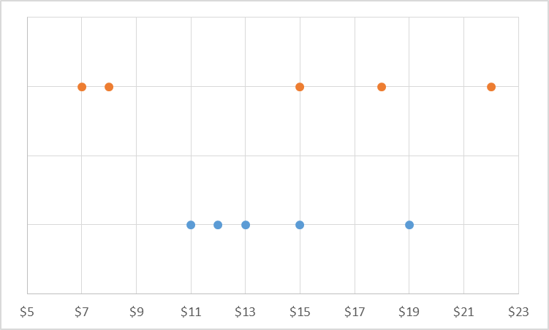
Variance – Visual Picture
How spread out is the data?
Does the mean fairly represent the data points?
Are the data points clustered around the mean?

Slide 26
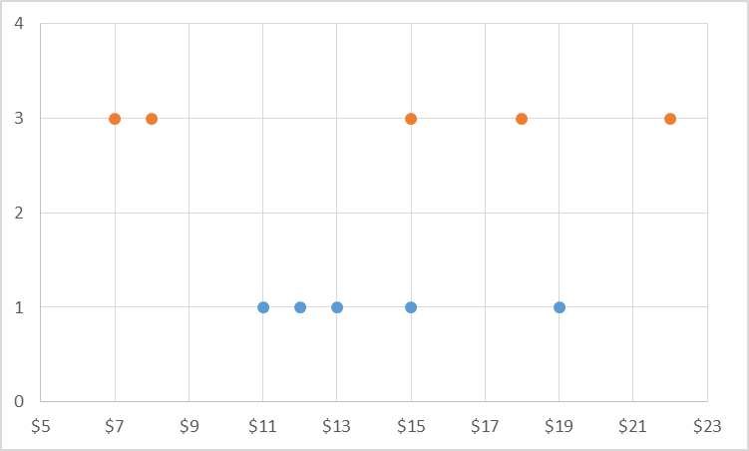
Variance – Standard Deviation
A measure of how far a set of numbers is spread out.
A variance of zero indicates that all the values are identical.
Square root of the variance is the Standard Deviation
1 Standard Deviation away from mean in both directions contains ~68% of the data
2 Standard Deviations away from mean in both directions contains ~95% of the data
3 Standard Deviations away from mean in both directions contains ~99.7% of the data
Variance | 8.00 | 33.20
Std Dev (S) | 3.16 | 6.44

